Slide 1
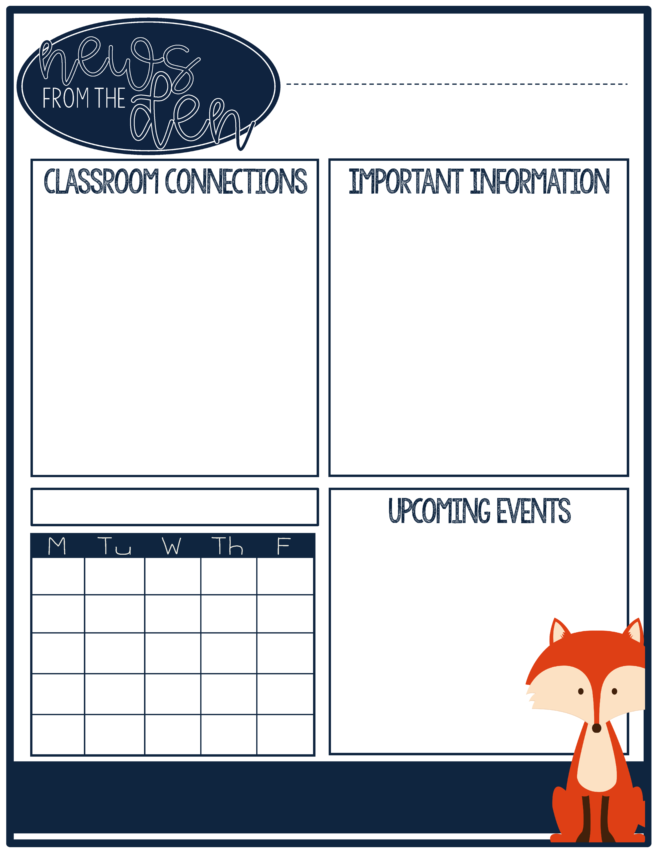
Dr. Shardell's Class
December 2020
In November, we completed a unit study on Native Americans and the early American colonists. As a final project, your child was asked to complete a project of their choice comparing and contrasting your child's life with the life of a colonist child. This is a great exercise your family can continue through the holidays. You can help your child compare your family's holiday celebrations with that of another time period or culture.
Par Excellence Academy is moving to at—home learning for December. It is important that your child checks Google Classroom daily for new assignments, in addition to joining their scheduled Zoom meetings or phone calls.
If your child has any questions on their work outside of their Zoom time, please email or text! I am happy to help your child in any way that I can.
Upcoming Units
This month, we will be doing a Holidays Around the World unit study to explore different celebrations and cultures.
We also recently began a new science and social studies curriculum that will transfer between at-home and at-school learning more seamlessly. I am happy to have an accessible and fun program that can easily be used at home!
December 15th—Family Night: Hop on Zoom to hear Santa read stories!
December 19-January 3—No school. Happy holidays!
5/
Be strong enough to stand alone, smart enough to know when you need help, and brave enough to ask for it.

Slide 2
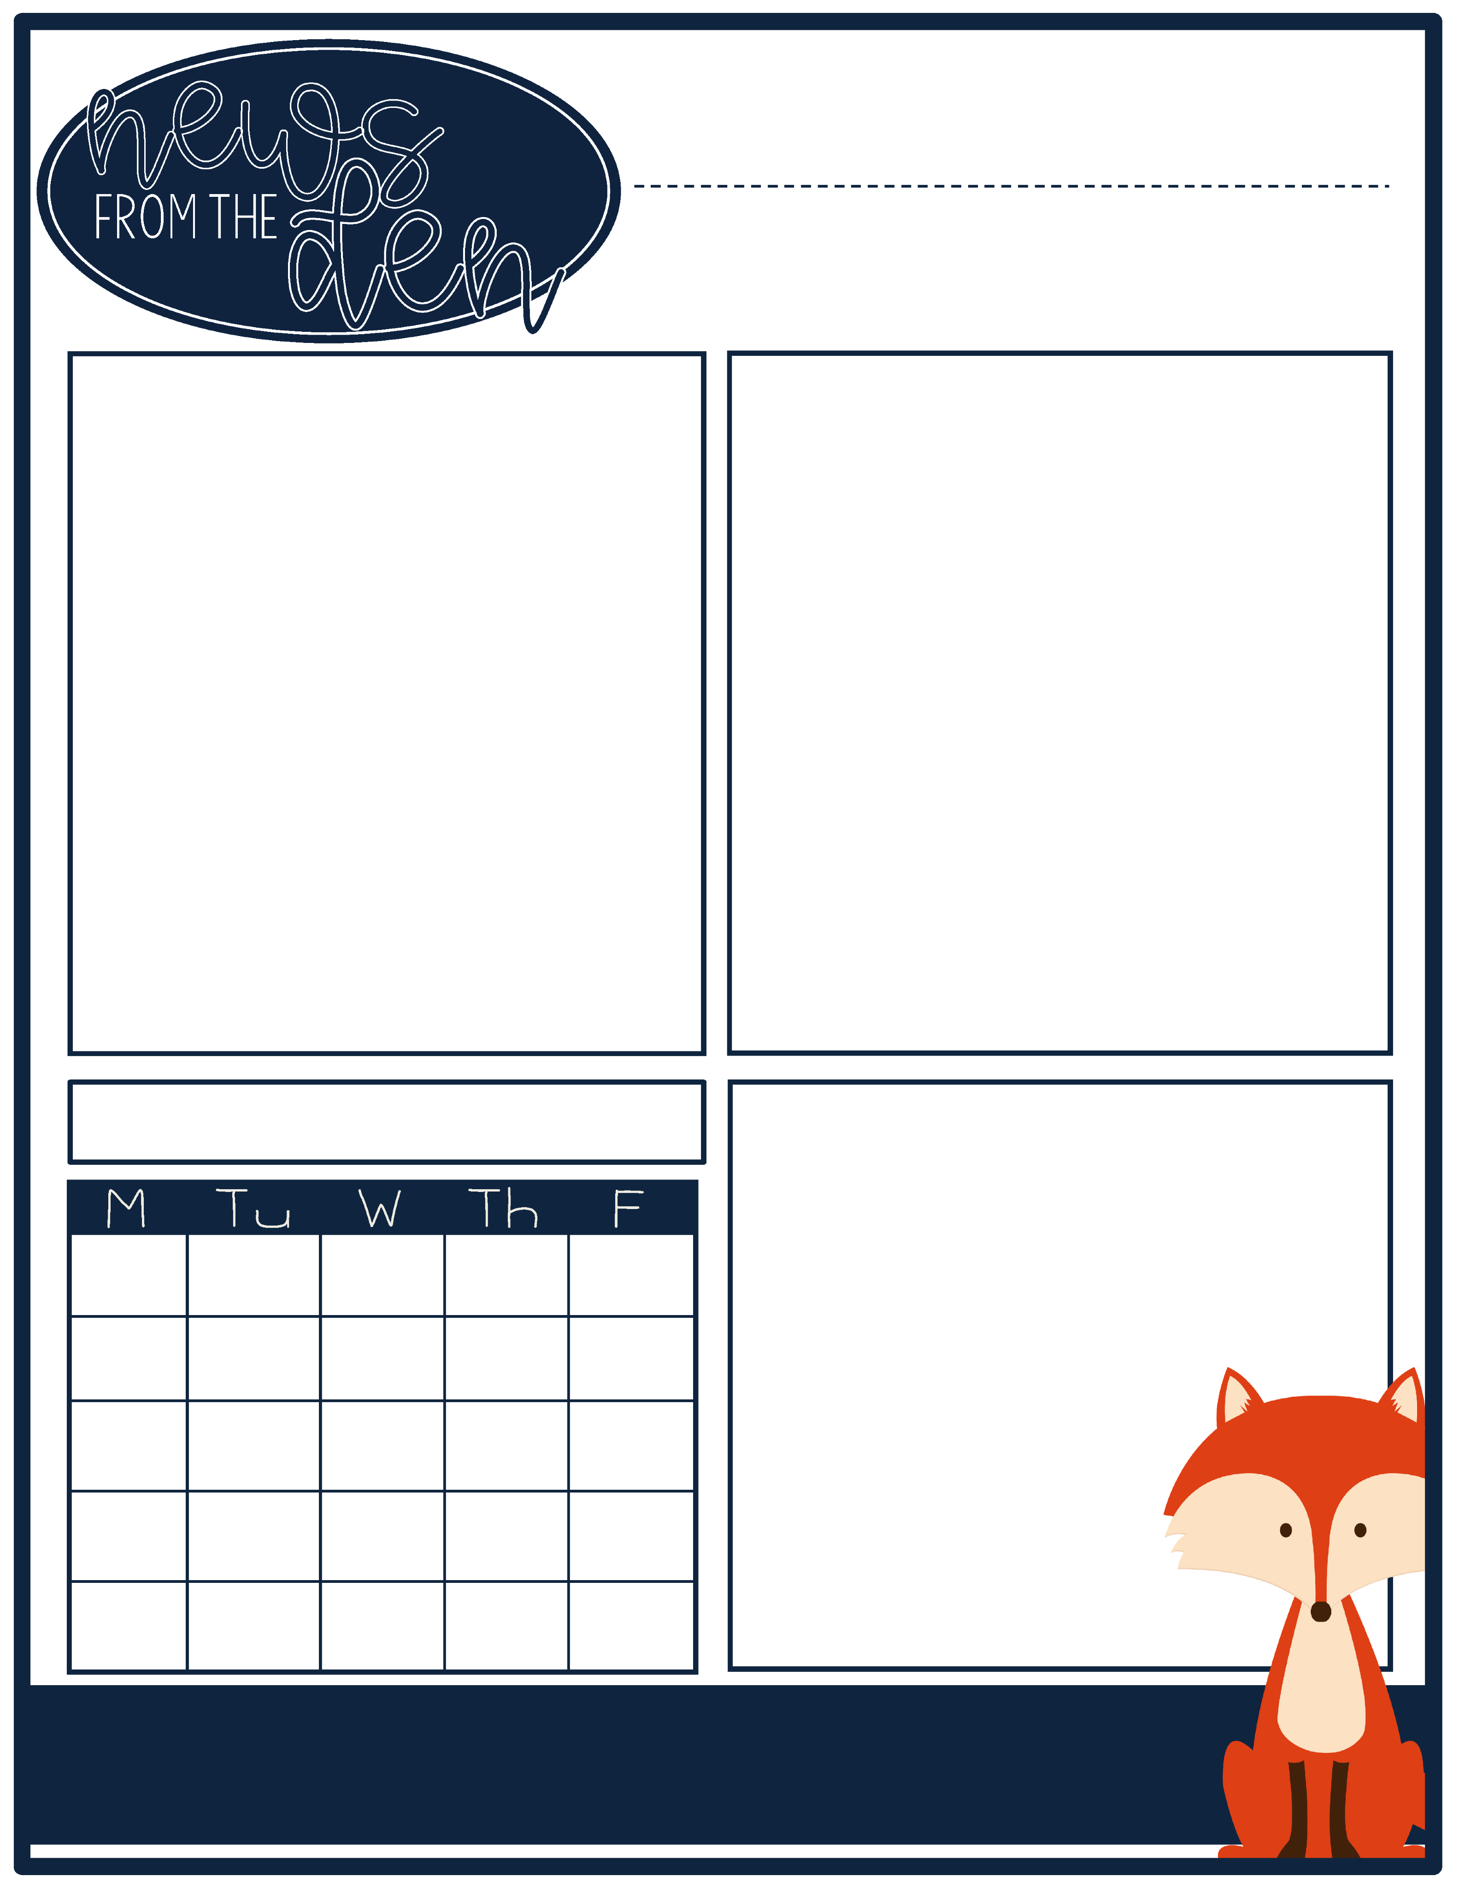
December 2020
In MATH, we’ve been learning:
In ELA, we’ve been learning…
Kindergarten—blending 3 letter words, recognizing sight words, & creating lists of writing topics
2nd grade—decoding 2 and 3 letter blends and using descriptive words in our writing
3rd & 4th grades—reading comprehension strategies & using interesting words to help readers make mind movies of our writing
Kindergarten—counting objects in different arrangements
2nd grade—adding 2 or 3 groups of objects
3rd & 4th grades—0s, 1s, 2s, 3s, and 4s multiplication facts
Month
In Social Emotional Learning, we’ve been learning…
How Can I Help My Child?
Read with your child every day. Have your child read to with you.
Practice addition facts (K-2nd grades) and multiplication facts (3rd-4th grades) daily.
Model communicating about your own emotions & helping your child put words to his or her feelings
Taking deep breaths when we feel frustrated or overwhelmed
How to check in and recognize our own emotions
What it means to be honest
It does not matter how slowly you go so long as you do not stop.

